Slide 1

Maze Solver using Graph Theory
By:
Satyam Shukla 15 BE COMP C
Ankush Singh 20 BE COMP C
Ankit Yadav 57 BE COMP C

Slide 2
CONTENTS
Problem Statement
The problem statement for the maze solver project is to implement a project that can find the shortest path through a given maze. The project should be able to take in a maze as input, and output the shortest path from the start point to the end point of the maze.
The maze is represented as a grid of cells, where each cell can be either open or closed. The start and end points are also specified. The goal is to find the shortest path from the start point to the end point, taking into account any walls or obstacles that may be present in the maze.
The maze solver should be able to handle mazes of varying sizes, and should be able to find the shortest path through any maze that is solvable. The algorithm should also be efficient, able to handle large mazes with minimal computational overhead.
The final product should be a functional program that takes a maze as input, finds the shortest path through the maze, and outputs the path visually. Additionally, the program should include any necessary documentation, testing, and reporting tools to ensure its functionality and reliability.

Slide 3
CONTENTS
Introduction
A maze solver is a program or algorithm that navigates through a maze to find the shortest path from a starting point to a destination point.
There are several different approaches to solving a maze, including:
1) Depth-First Search (DFS): This algorithm explores each possible path in the maze until it reaches the destination point.
2) Breadth-First Search (BFS): This algorithm explores all possible paths at each level of the maze before moving on to the next level.
3) Dijkstra's Algorithm: This algorithm is a variation of BFS that takes into account the weights of the edges in the maze.
4) A* Algorithm: This algorithm combines both BFS and Dijkstra's Algorithm by considering both the distance from the starting point and the estimated distance to the destination point.
Once a maze solver algorithm has found the shortest path, it can be used to guide a robot or other device /or a person through the maze to reach the destination point.

Slide 4
CONTENTS
Literature Survey
"Solving mazes using genetic algorithms" by R. H. Kabwe and T. N. Golele. In this paper, the authors proposed a genetic algorithm approach for maze solving. The algorithm uses a population of solutions that are iteratively evolved and selected based on their fitness score. The fitness score is determined by the length of the path and the number of steps taken to reach the destination.
"A comparative study of maze-solving algorithms" by T. Arun Kumar and M. Chandrasekaran. This paper presents a comparative study of different maze-solving algorithms, including breadth-first search, depth-first search, and A* search. The authors analyzed the performance of these algorithms on different maze configurations and concluded that A* search is the most efficient algorithm for maze solving.
"Intelligent maze solving algorithm using ant colony optimization" by N. M. Singh and M. K. Tiwari. This paper presents an ant colony optimization approach for maze solving. The algorithm uses a colony of virtual ants that leave pheromone trails to guide their movement through the maze. The experimental results show that the ant colony optimization algorithm is effective in solving mazes of varying complexity.
"A new approach to maze solving using fuzzy logic" by S. Banerjee and S. Das. In this paper, the authors propose a fuzzy logic-based approach for maze solving. The algorithm uses fuzzy rules to determine the direction of movement based on the current location and surrounding environment. The experimental results show that the fuzzy logic-based approach is effective in solving mazes of varying complexity.
"Multi-objective optimization for solving mazes" by Y. Zhang and J. Hu. This paper presents a multi-objective optimization approach for maze solving. The algorithm uses multiple fitness functions, such as the length of the path, the number of steps taken, and the number of turns made, to guide the search process. The experimental results show that the multi-objective optimization approach is effective in finding optimal solutions for mazes with multiple objectives.

Slide 5
CONTENTS
Approach
Start at the entrance of the maze
Mark the current cell as visited.
If the current cell is the exit of the maze, return the path taken to reach it.
Otherwise, for each unvisited neighbor of the current cell, recursively call the algorithm from that neighbor.
If any recursive call returns a path to the exit, append the current cell to the path and return the combined path.
If no path to the exit is found from the current cell, remove it from the path and backtrack to the previous cell.
Continue this until the destination is found.
Backtrack and give the optimal path.

Slide 6
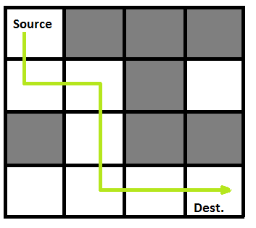
CONTENTS
Reference Diagram

Slide 7



CONTENTS
Software Used

Slide 8
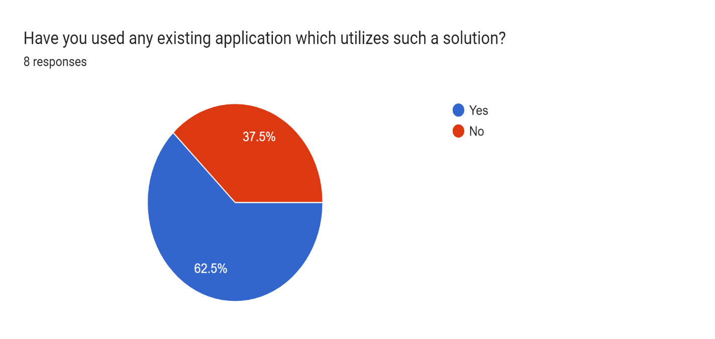
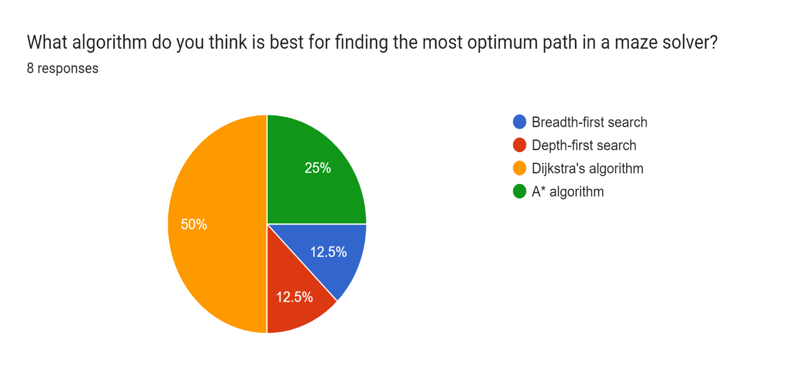
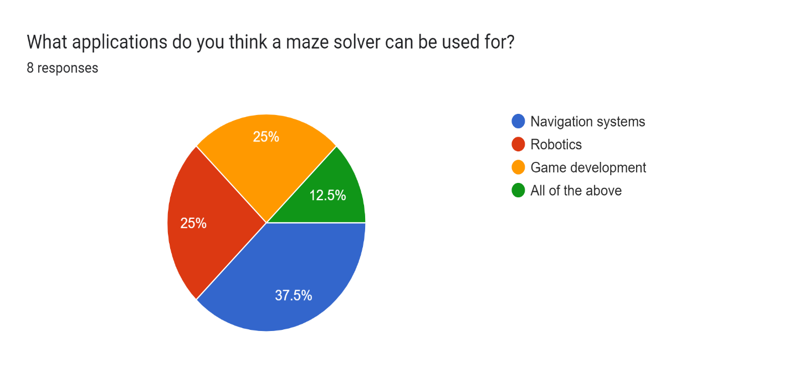
CONTENTS
Survey Results

Slide 9
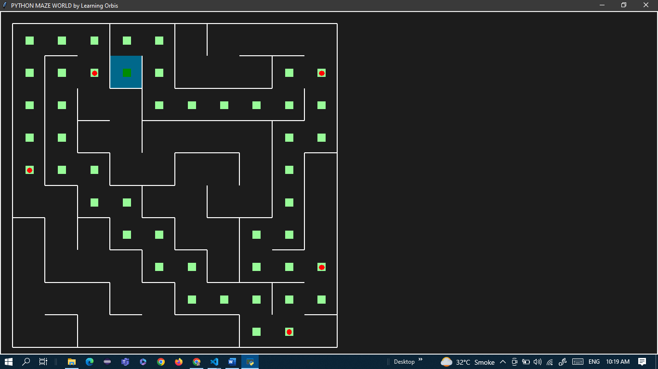
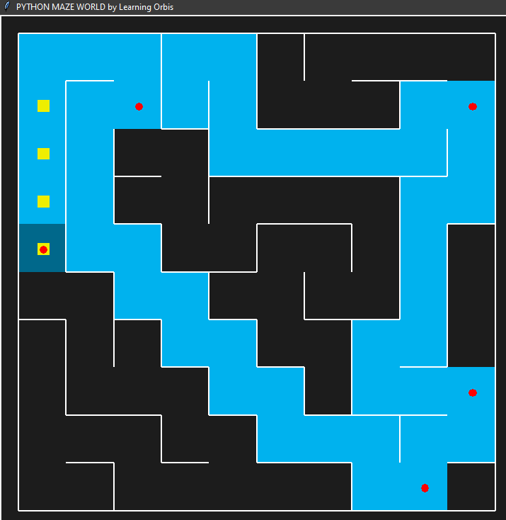
CONTENTS
Project demo & Results

Slide 10
CONTENTS
Conclusion
In conclusion, maze solver algorithms are a fundamental tool for solving maze navigation problems and enabling autonomous navigation and path planning in complex environments. These algorithms use graph theory and optimization techniques to find the optimal path from the starting point to the destination point in the maze.
The implementation of a maze solver can be done using various search algorithms such as Breadth-First Search, Depth-First Search, Dijkstra's Algorithm, or A* Algorithm. The choice of algorithm depends on the requirements and constraints of the application, including the optimality of the path found and the computational resources required.
Maze solver algorithms have a wide range of applications, including robotics, gaming, path planning, image processing, and education. The ability to apply maze solver algorithms in various fields and scenarios highlights the importance of developing efficient and scalable implementations of these algorithms.

Slide 11

CONTENTS

